Slide 1
CUSTOMER RETENTIONS IN ECOMMERCE WEBSITES AVAILABLE IN INDIA
submitted by:
Vaishali Shukla

Slide 2
INTRODUCTION
Customer satisfaction has emerged as one of the most important factors that guarantee the success of online store; it has been posited as a key stimulant of purchase, repurchase intentions and customer loyalty.
A comprehensive review of the literature, theories and models have been carried out to propose the models for customer activation and customer retention.
Five major factors that contributed to the success of an e-commerce store have been identified as: service quality, system quality, information quality, trust and net benefit.
The research furthermore investigated the factors that influence the online customers repeat purchase intention. The combination of both utilitarian value and hedonistic values are needed to affect the repeat purchase intention (loyalty) positively.
Source(Google)

Slide 3
The data is collected from the Indian online shoppers. Results indicate the e-retail success factors, which are very much critical for customer satisfaction.
Five major factors that contributed to the success of an e-commerce store have been identified as: service quality, system quality, information quality, trust and net benefit.
The research furthermore investigated the factors that influence the online customers repeat purchase intention.

Slide 4
objectives for the Problem Undertaken
Our main objective of doing this project is to analyse whether the users are shopping products from e-commerce websites, how did they give feedbacks to these websites on the basis of several positive and negative factors and also the details of the users on basis of factors like age, gender, etc.

Slide 5
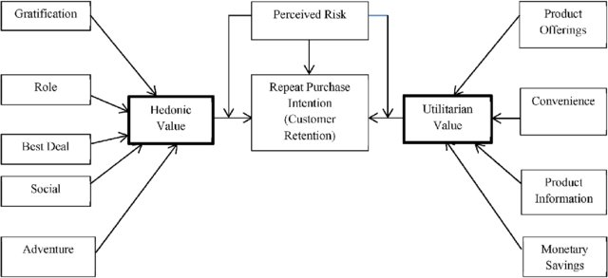
Diagrammatic Representation of Customer Retention
Source(Google)

Slide 6
Data Sources and their formats
The data is been given by a highly-confidential company and they gave it to us in an excel file.
They also had provided the problem statement by explaining what they need from us and also the required criteria to be satisfied.
Let’s check the data now. I have attached the snippet below to give an overview.
There are total 269 rows and 71 columns in this dataset
Our objective is to find the insights of the data and to do data analysis.

Slide 7
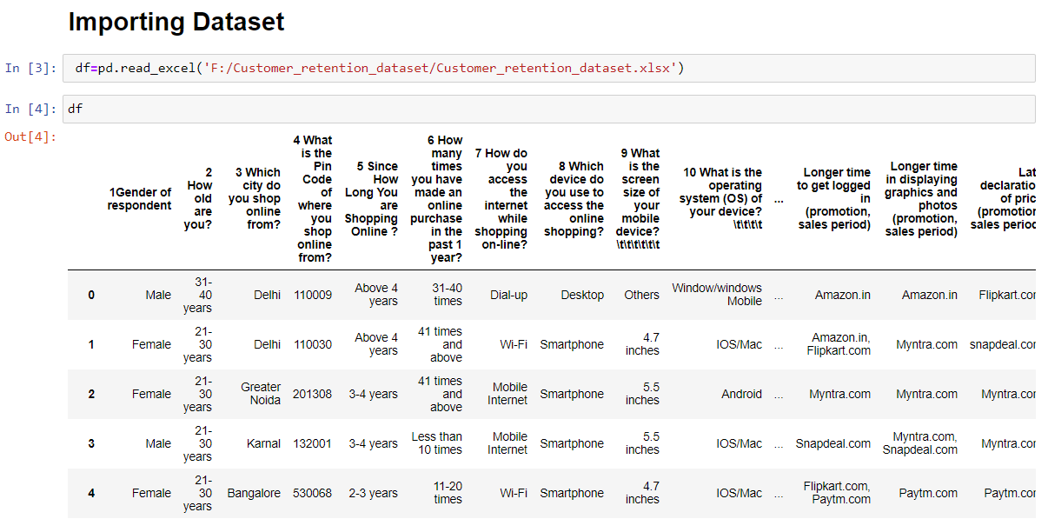

Slide 8
HARDWARE, SOFTWARE AND LIBRARY REQUIREMENTS
For doing this project, the hardware used is a laptop with high end specification and a stable internet connection. While coming to software part, I had used anaconda navigator and in that I have used Jupyter notebook to do my python programming and analysis.
For using an excel file, Microsoft excel is needed. In Jupyter notebook, I had used lots of python libraries to carry out this project and I have mentioned below with proper justification:
1. Pandas- a library which is used to read the data, visualisation and analysis of data.
2. NumPy- used for working with array and various mathematical techniques.
3. Seaborn- visualization tool for plotting different types of plot.
4. Matplotlib- It provides an object-oriented API for embedding plots into applications.

Slide 9
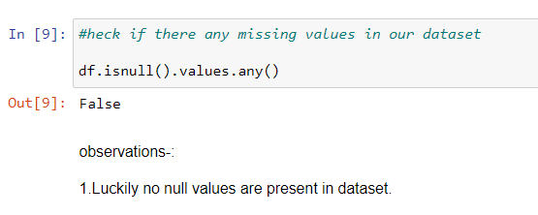
DATA ANALYSIS
There are no null values in this dataset and 70 columns are of object datatype and only 1 column is of int64 data type.

Slide 10
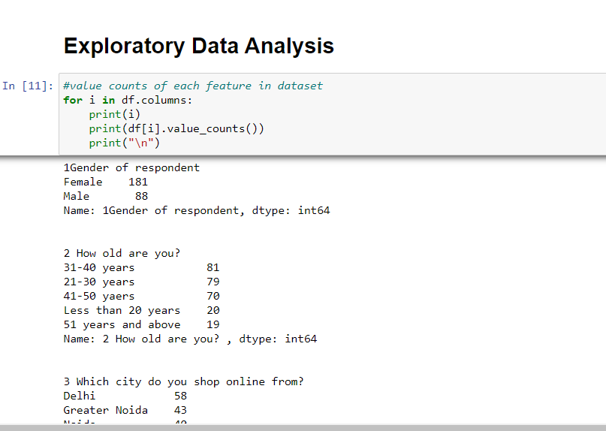
Here we see the value counts of all 71 columns above and we iterated using a for loop. We can see some value counts of the columns like gender, age, city, etc.

Slide 11
Analysis of website feedbacks obtained
Here we see that after column 47, there are both positive and negative feedbacks of the websites, which are given by the correspondents. We will analyse those data by using data analysis process.
First, we will extract only the feedbacks data and then save it in a new data frame, which will be used for further process.

Slide 12
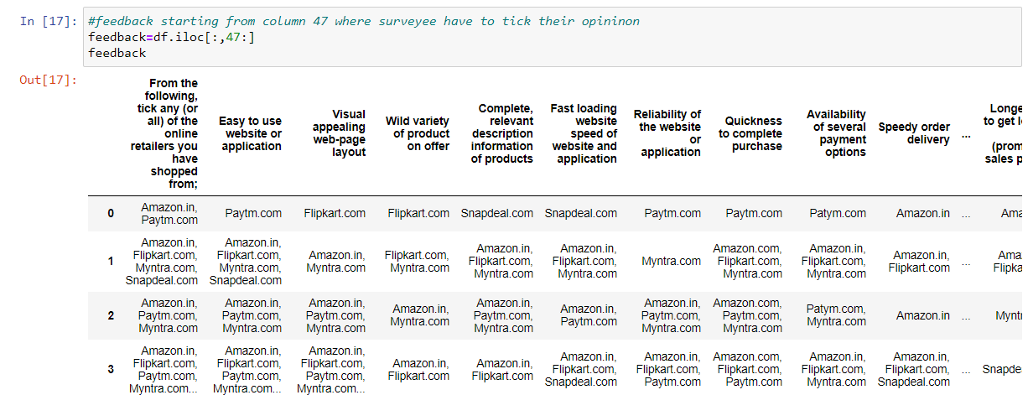

Slide 13
We will analyse the negative feedbacks first by checking the count of websites and the type of feedbacks given to each website. Then, we will save the obtained data in a new data frame and rename the column names.
Then, we will analyse the positive feedbacks by checking the count of websites and the type of feedbacks given to each website. Then, we will save the obtained data in a new data frame and rename the column names.
We will calculate the percentage of people giving the feedbacks to the website for both positive and negative data.

Slide 14
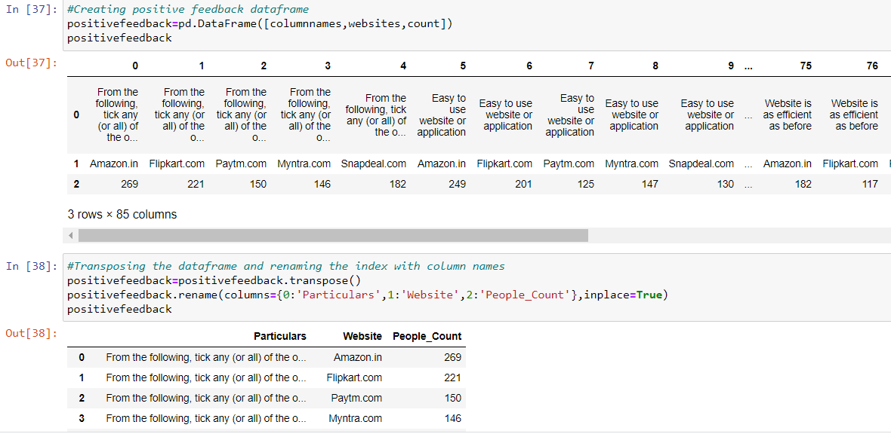

Slide 15
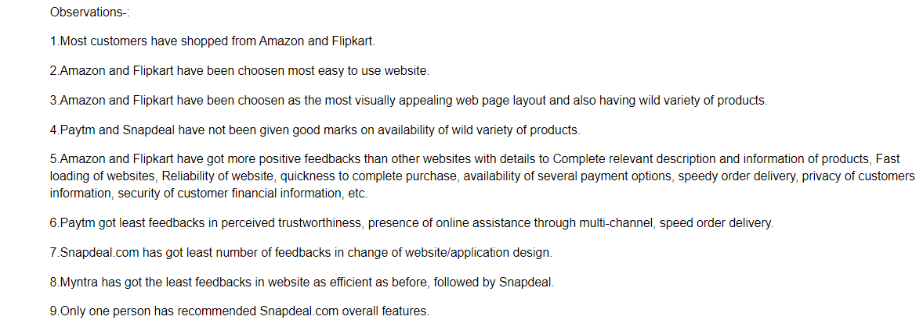
Observations for positive data

Slide 16
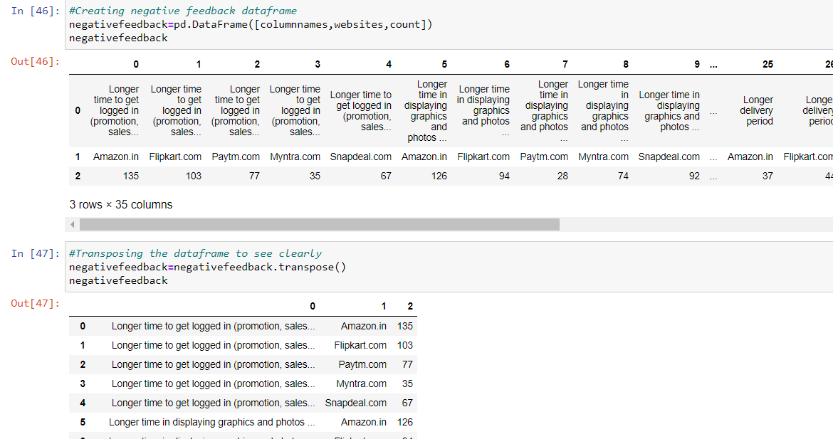

Slide 17
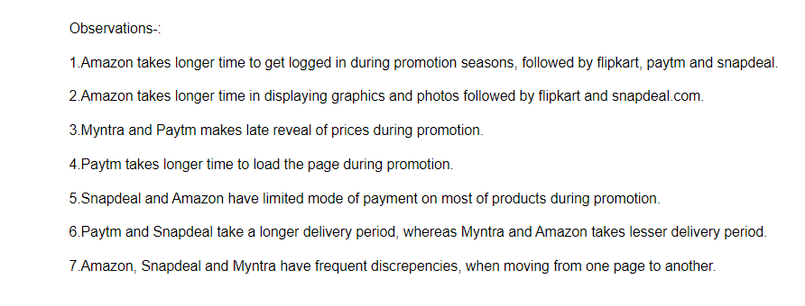
Observations for negative data

Slide 18
DATA VISUALIZATION
Now, we will see the different plots done with this dataset in order to know the insight of the data present. Below are the codes given for the plots and the output obtained:
Here are some of the outputs obtained after running the above code:

Slide 19
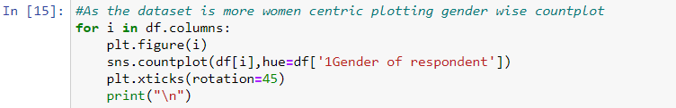
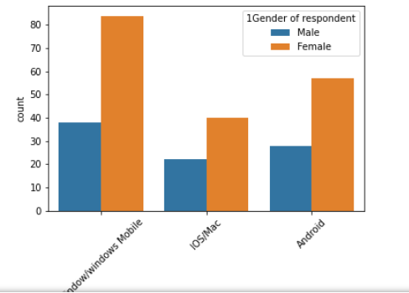

Slide 20
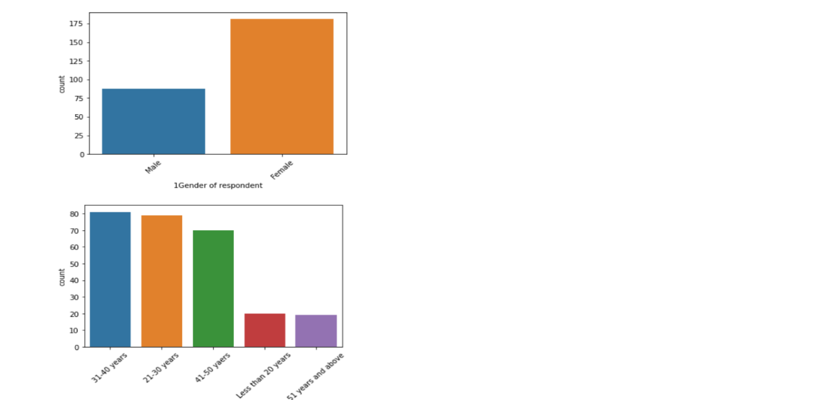

Slide 21
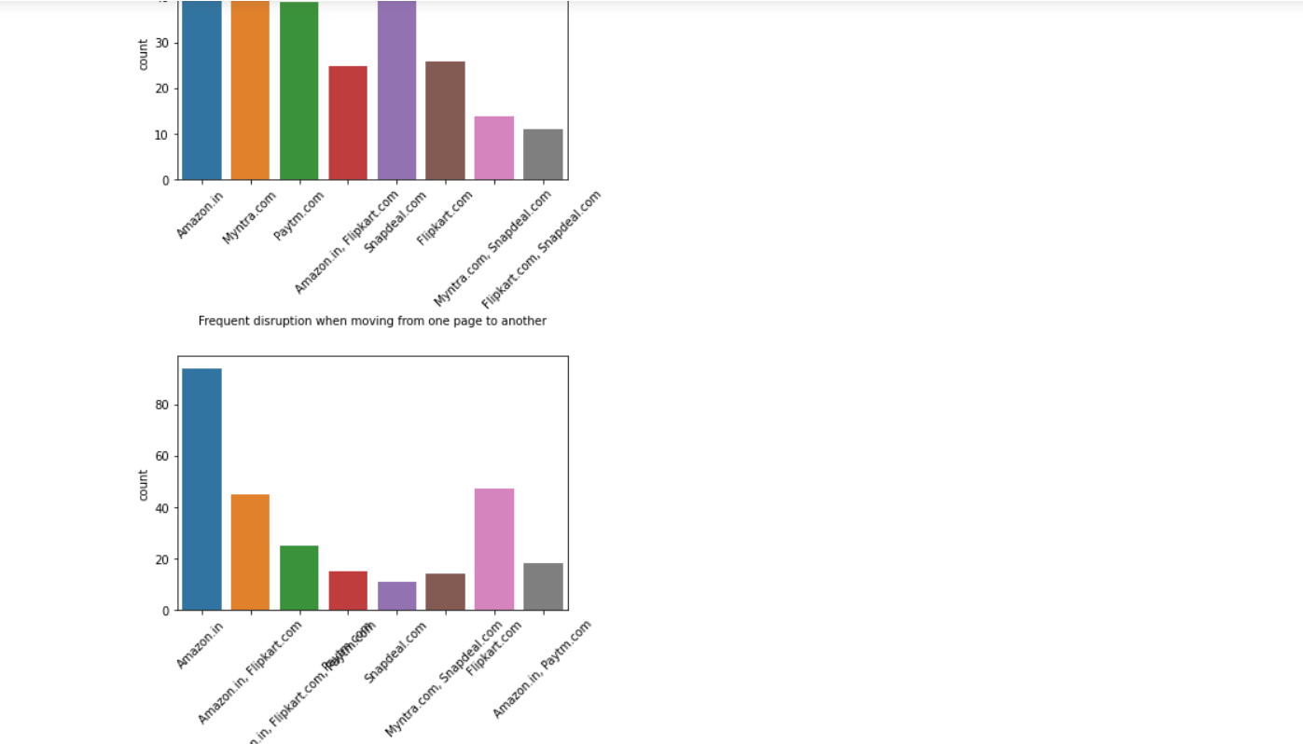

Slide 22
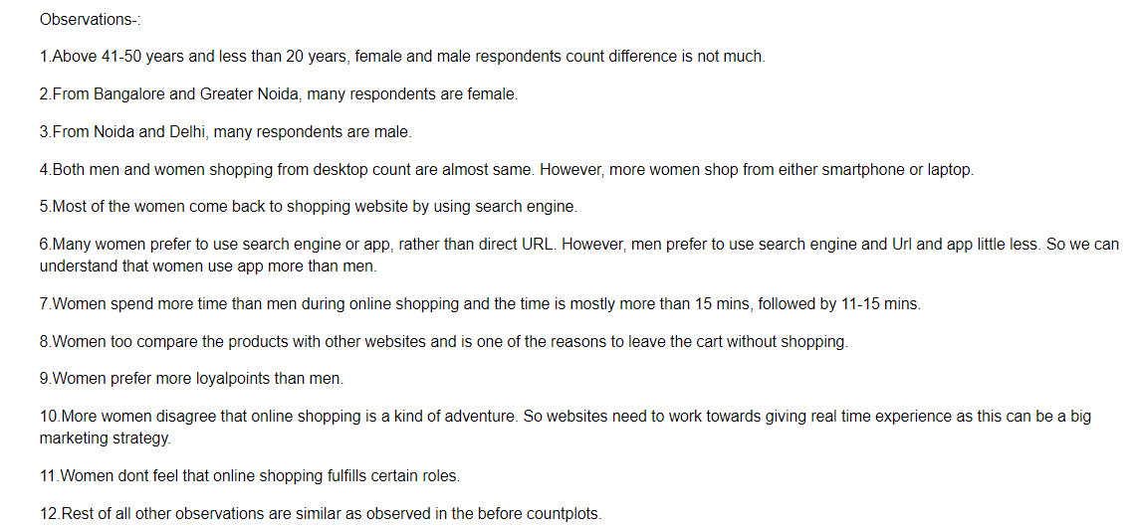
Observations from the count plot

Slide 23
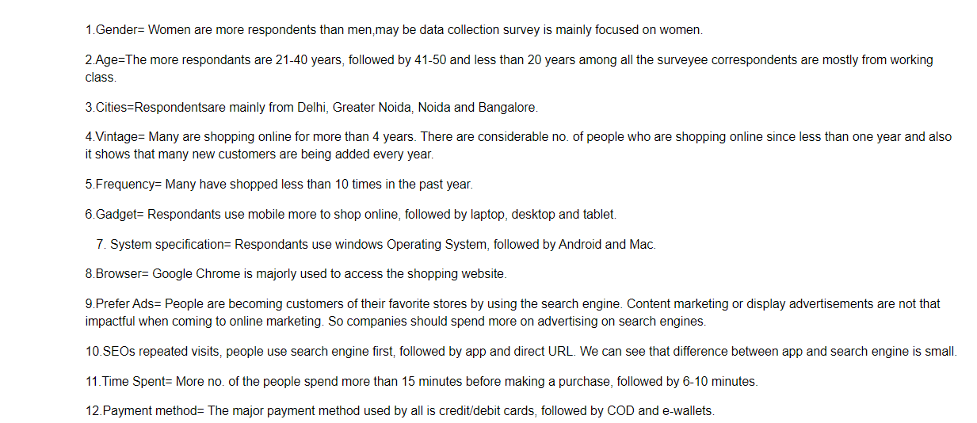

Slide 24
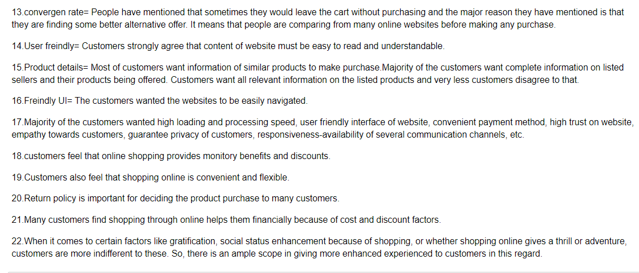

Slide 25
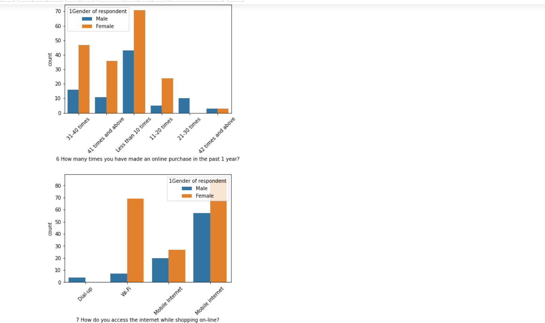
Count plot for gender

Slide 26
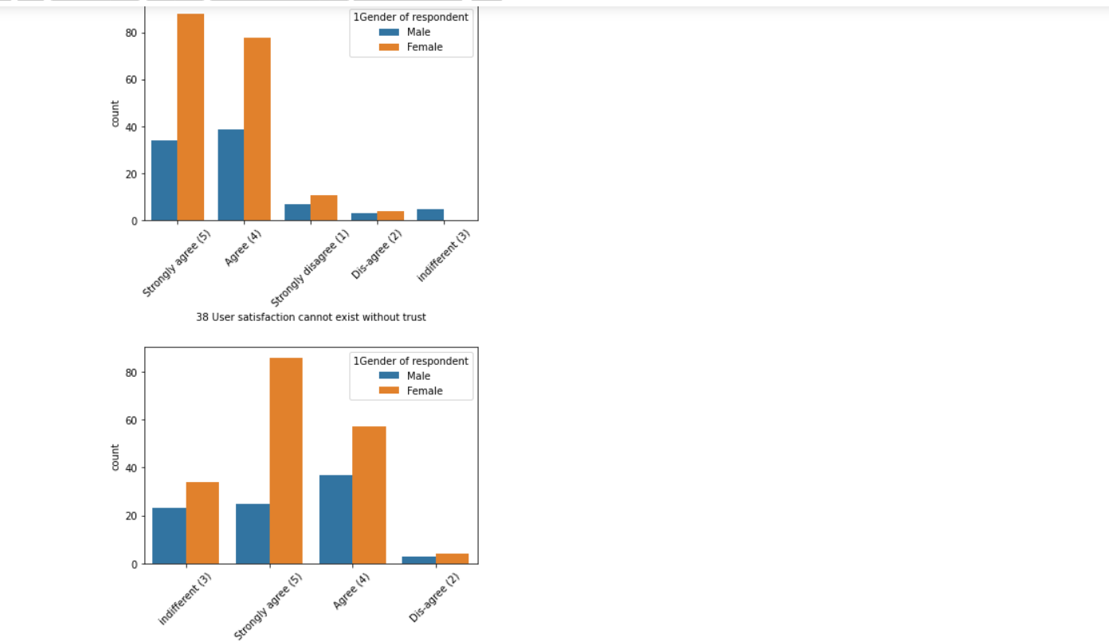

Slide 27
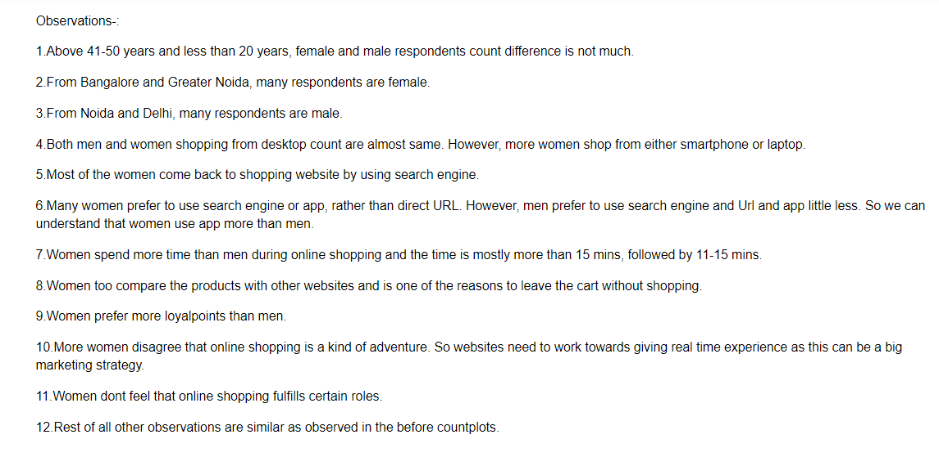
Observations

Slide 28
Website Vs People count for negative feedback
During the promotion time, Amazon has received more negative feedback from customers followed by Snapdeal, Flipkart and Paytm.
We can note that difference between negative feedbacks of the websites is not very huge and it needs to be improved in order to handle such situations.

Slide 29
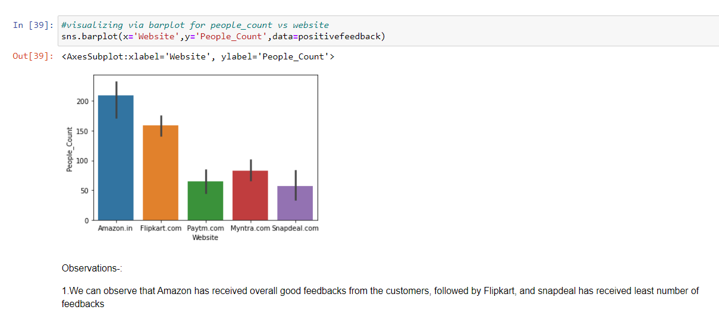

Slide 30
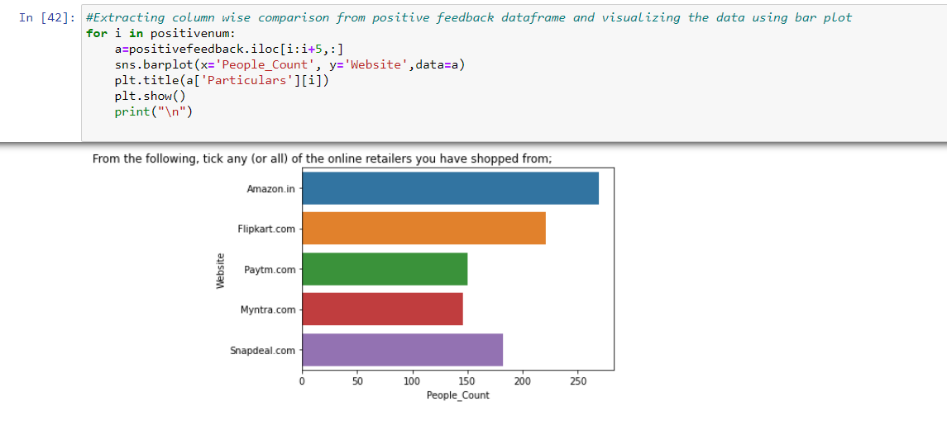

Slide 31
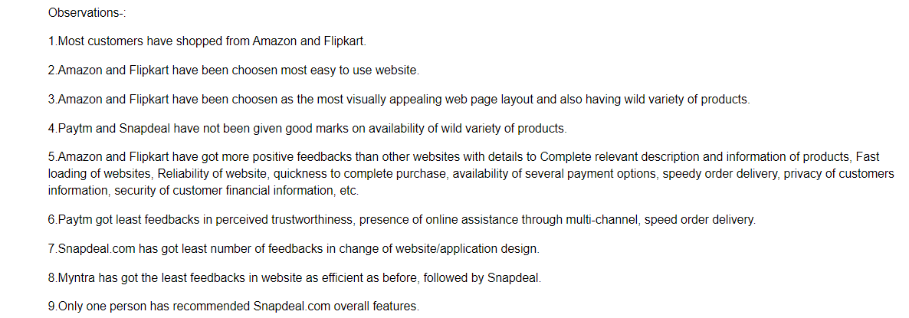
Observations

Slide 32
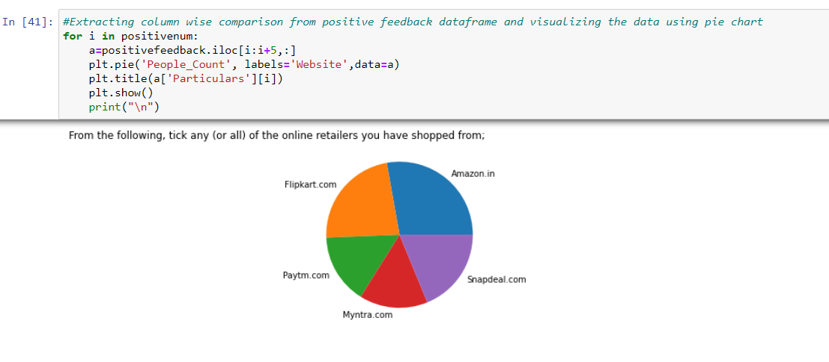
Other informative Visualizations

Slide 33
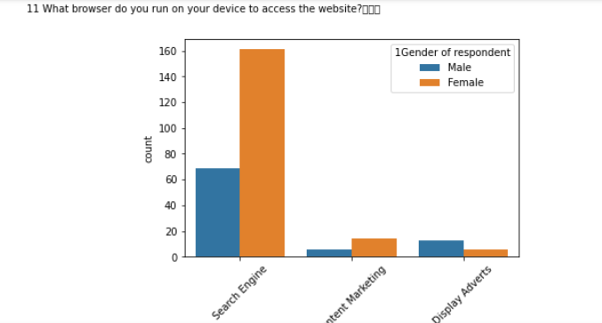

Slide 34
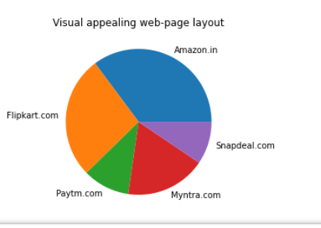
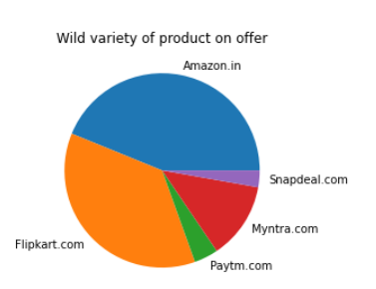

Slide 35
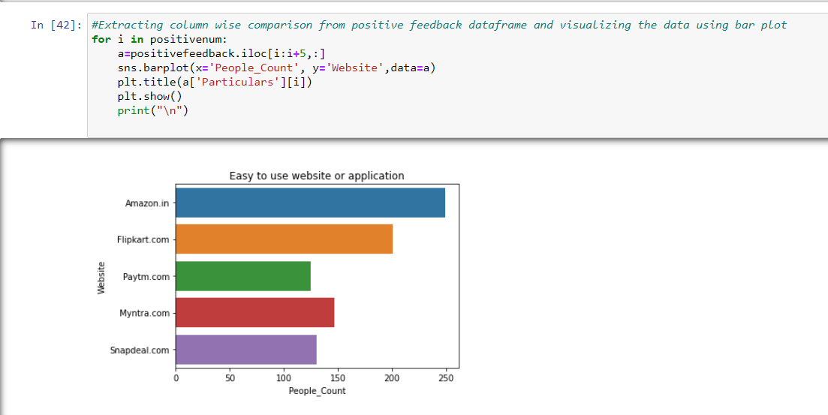
Feature wise comparison from positive feedback data frame and plotting bar plot

Slide 36
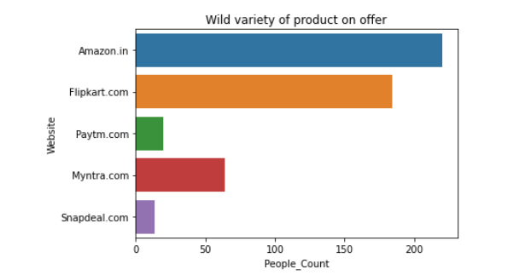
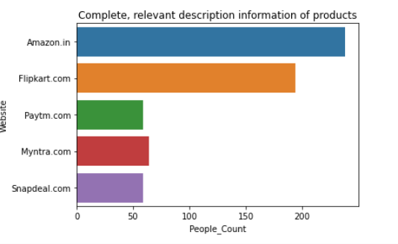

Slide 37
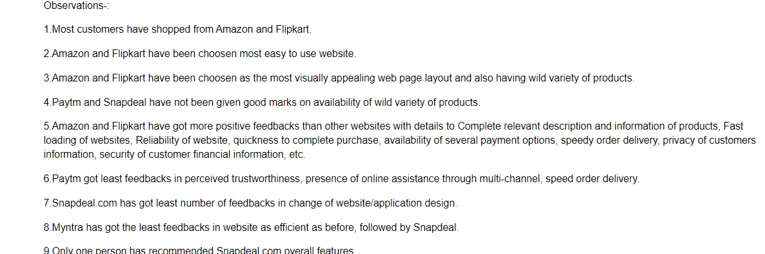
Observations

Slide 38
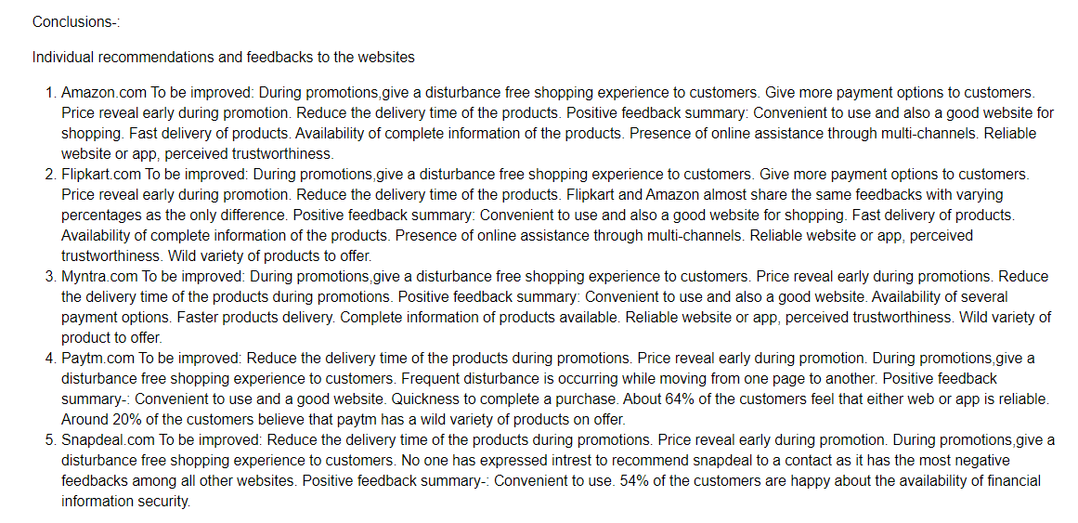
CONCLUSIONS

Slide 39
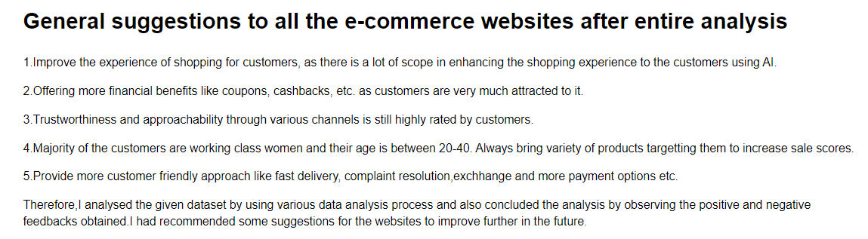

Slide 40


